Slide 1
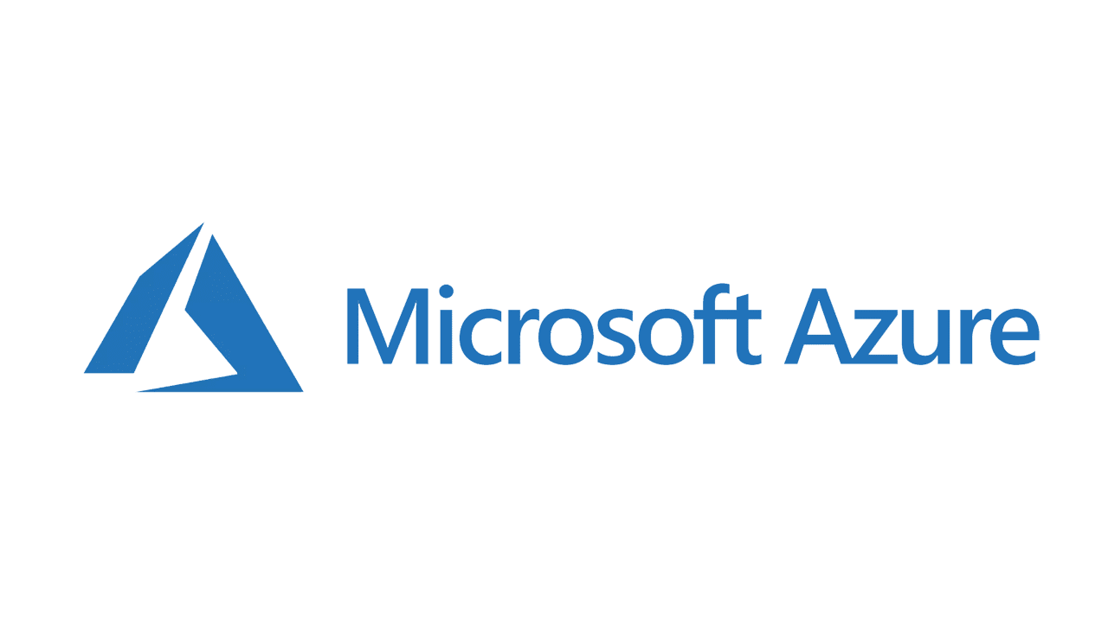

Slide 2
Tahawar Ihsan Alpha Microsoft Learn Student Ambassador
Doing BS-CS from National University of computer and emerging sciences (Fast) Pakistan

Slide 3
Topic to cover What is Azure? Cloud Computing Virtual Machine Static web app

Slide 4
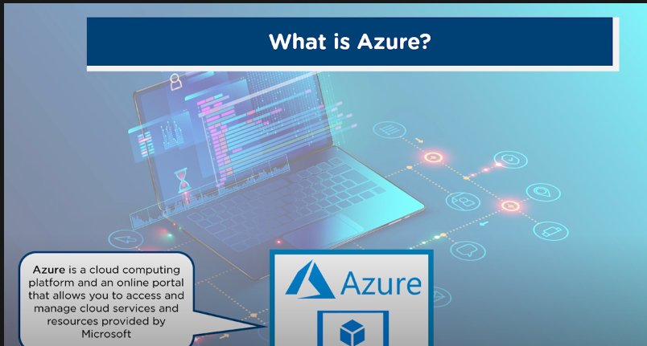
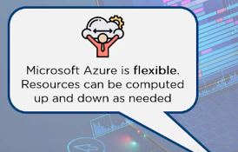
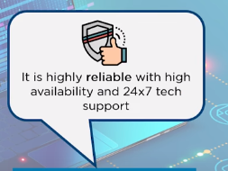
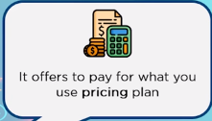
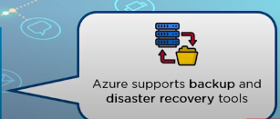

Slide 5
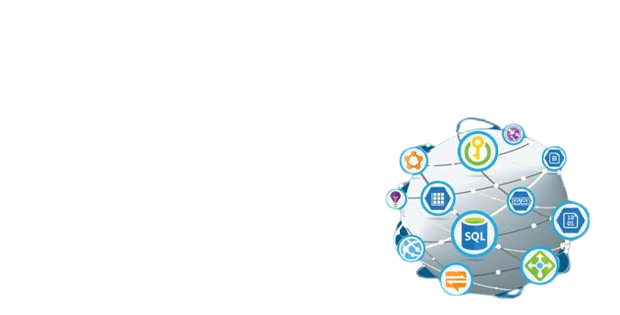
What is Azure?
Cloud Computing Platform
200 products and cloud services
- Lie under IaaS PaaS & SaaS

Slide 6
Cloud Computing

Slide 7
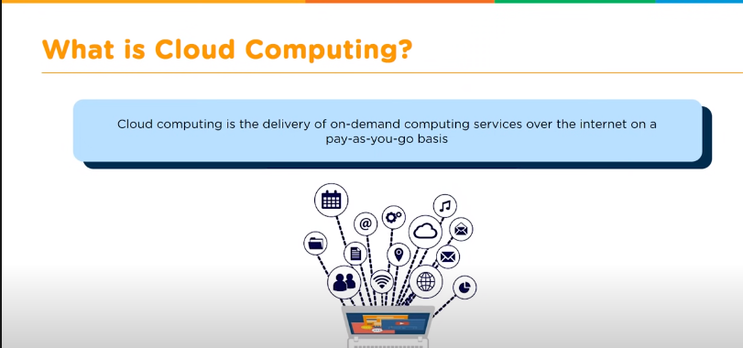

Slide 8
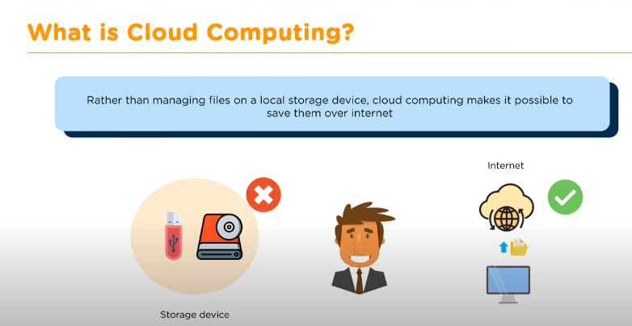

Slide 9
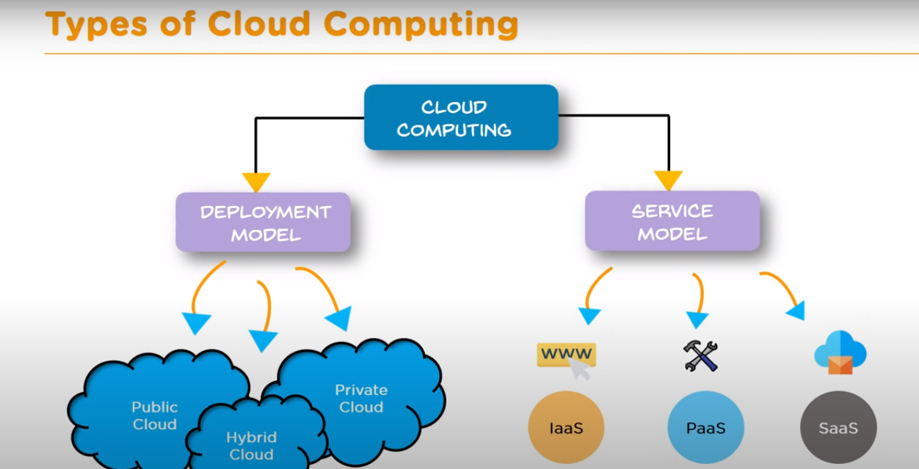

Slide 10
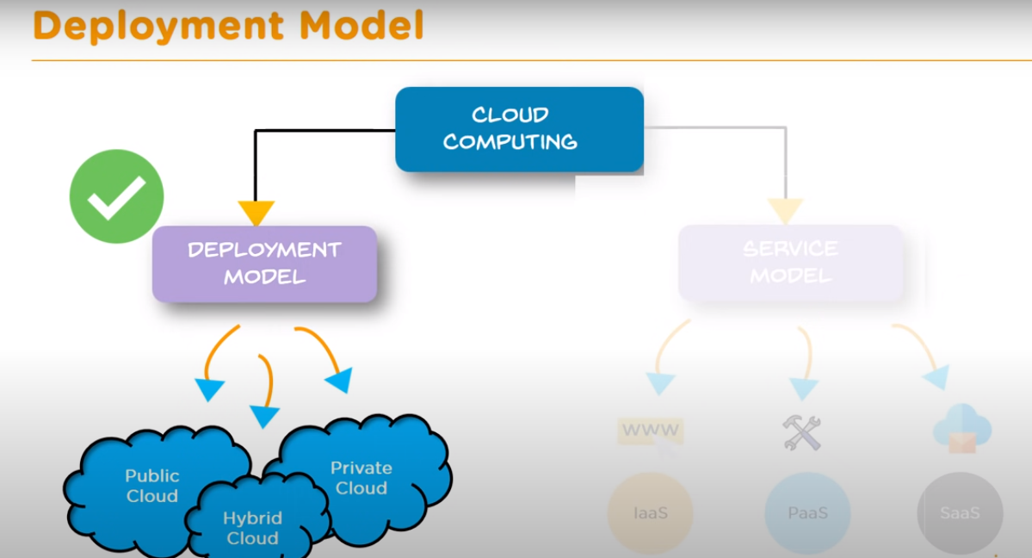

Slide 11
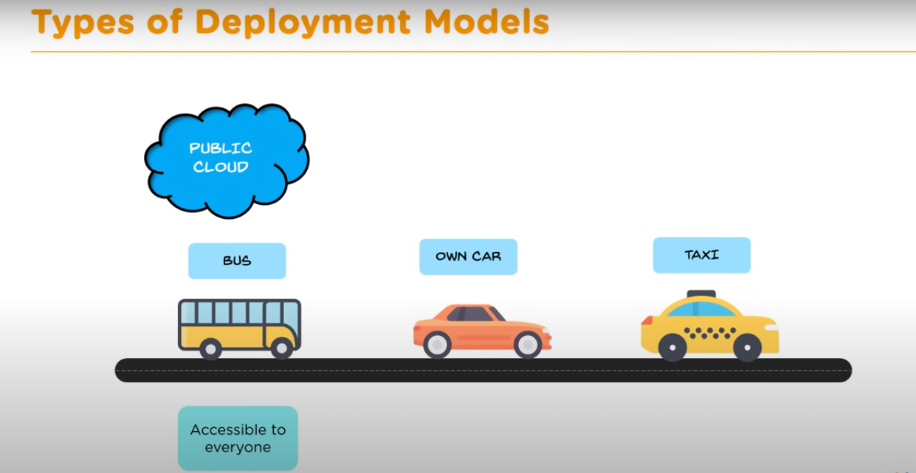

Slide 12
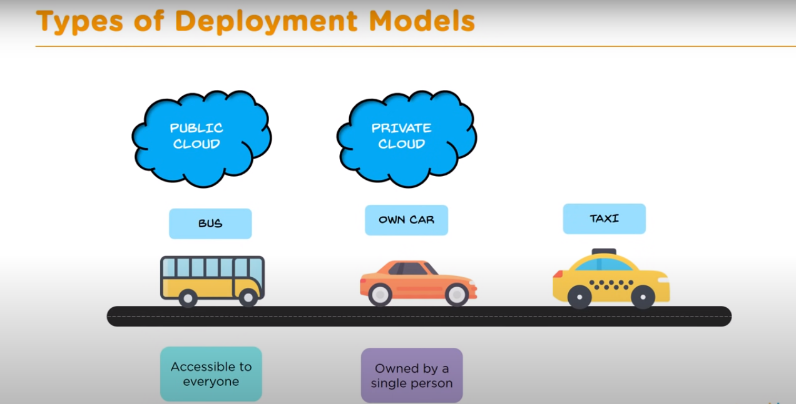

Slide 13
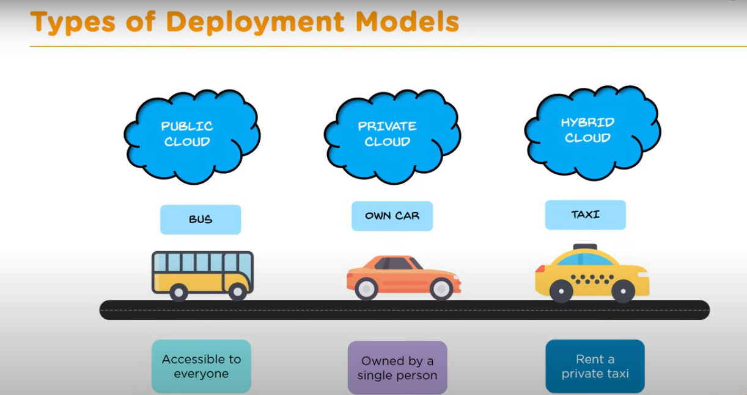

Slide 14
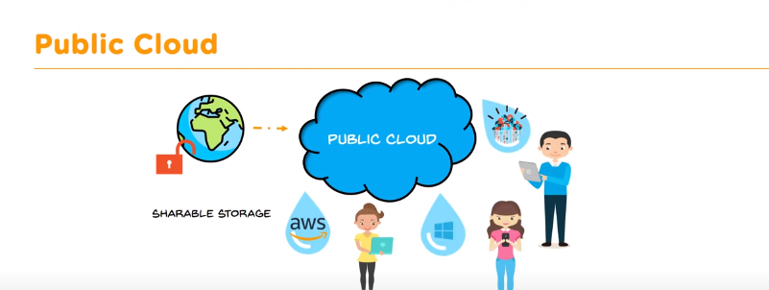

Slide 15
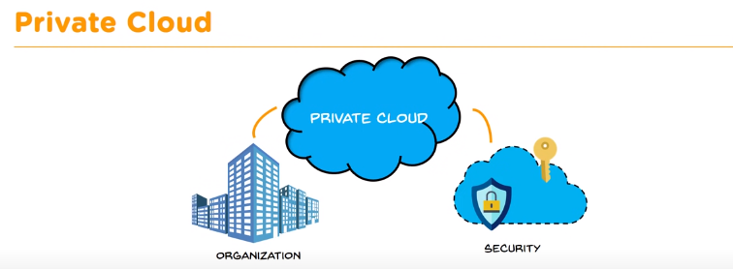

Slide 16
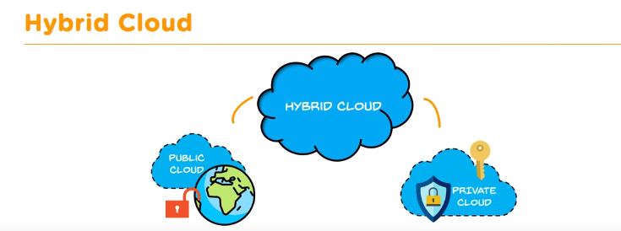

Slide 17
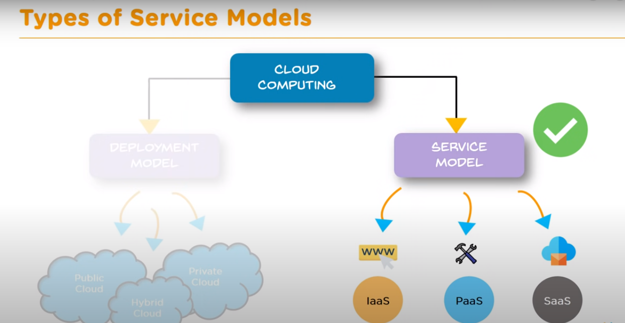

Slide 18
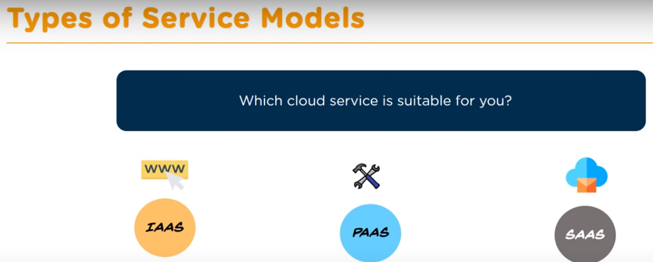

Slide 19
Cloud Flavors?
SaaS – Software as a Service
IaaS – Infrastructure as a Service
PaaS – Platform as a Service
DaaS – Desktop as a Service

Slide 20
What is Software as a Service? (SaaS)
SaaS is a software delivery methodology that provides licensed multi-tenant access to software and its functions remotely as a Web-based service.
Usually billed based on usage
Usually multi tenant environment
Highly scalable architecture

Slide 21
SaaS is not ASP 2.0
The ASP model concentrated on providing an organization with the ability to move certain application processing duties to leased third-party managed servers.
ASPs were not necessarily concerned about providing shared services to multiple tenants, but rather hosting a dedicated application on behalf of the customer.
Most ASPs did not possess the required amount of application and business knowledge regarding the applications they were running.

Slide 22
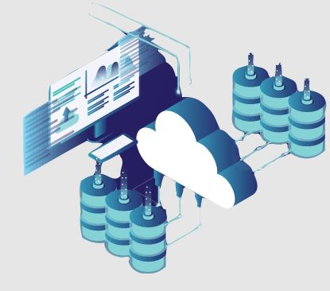
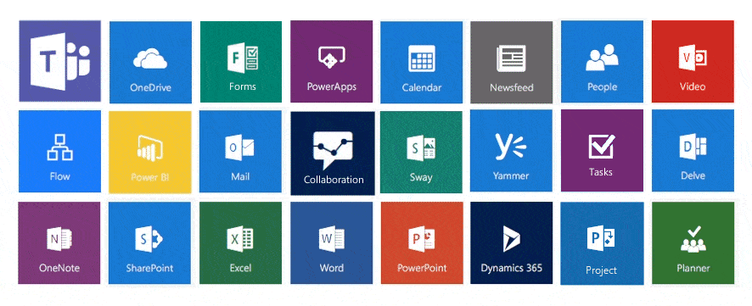
Azure & SaaS
Microsoft responsible for managing everything
Software delivered via the internet
User responsible for configuring the SaaS solution
User only needs to login and access

Slide 23
SaaS advantages
Flexible payments
Scalable usage
Automatic updates
Accessibility and persistence
Customization

Slide 24
Infrastructure as a Service (IaaS)
IaaS is the delivery of technology infrastructure as an on demand scalable service
Usually billed based on usage
Usually multi tenant virtualized environment
Can be coupled with Managed Services for OS and application support

Slide 25
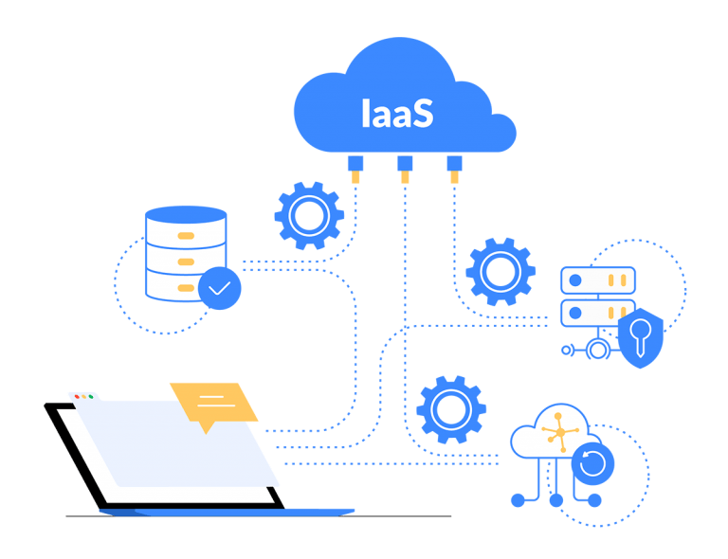
IaaS on Azure
Outsourcing all network & computing needs to Microsoft
Removing all infrastructure & basing it on Microsoft’s end
Offering massive range of IaaS facilities depending on the needs
Hassle free

Slide 26
IaaS is not Managed Hosting
Traditional managed hosting is a form of web hosting where a user chooses to lease entire server(s) housed in an off-site data center.
Term based contracts based on projected resource requirements

Slide 27
Common IaaS business scenarios
Lift-and-shift migration
Test and development
Storage, backup, and recovery
Web apps
High-performance computing

Slide 28
Advantages of IaaS
Reduces capital expenditures and optimizes costs
Increases scale and performance of IT workloads
Increases stability, reliability, and supportability
Enhances security

Slide 29
Platform as a Service (PaaS)
PaaS provides all of the facilities required to support the complete life cycle of building and delivering web applications and services entirely from the Internet.
Typically applications must be developed with a particular platform in mind
Multi tenant environments
Highly scalable multi tier architecture

Slide 30
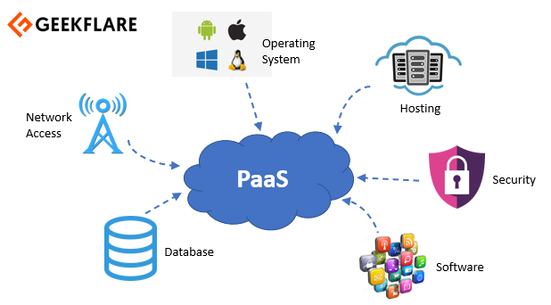
PaaS on Azure
Help user implement a cloud-powered development platform
Give developers total control over their application
Freedom to work on building
Safe in the knowledge that things like operating system patches or load balancing will just work.

Slide 31
Common PaaS scenarios
Development framework
Analytics or business intelligence
Additional services

Slide 32
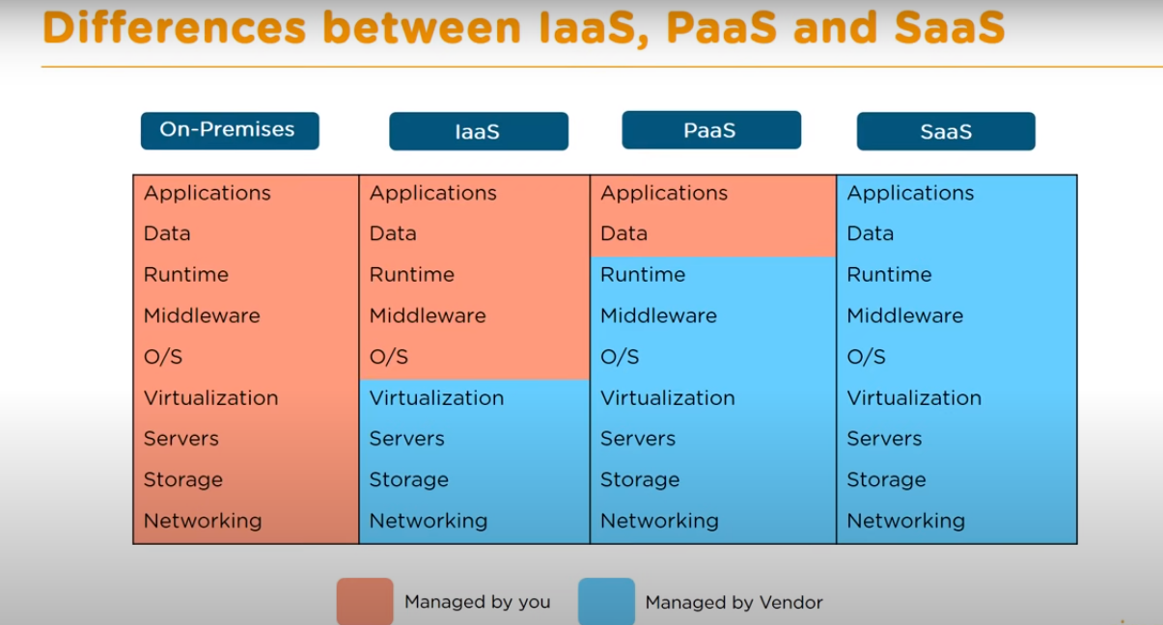

Slide 33
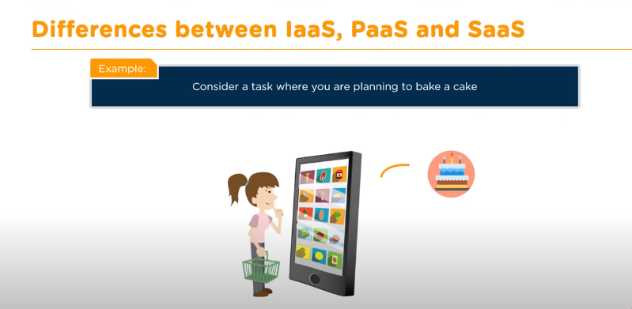

Slide 34
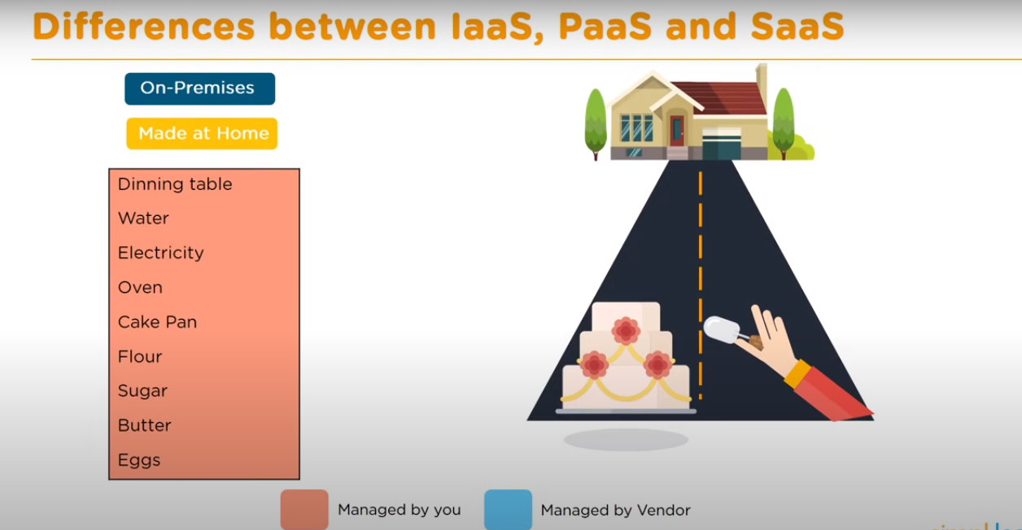

Slide 35
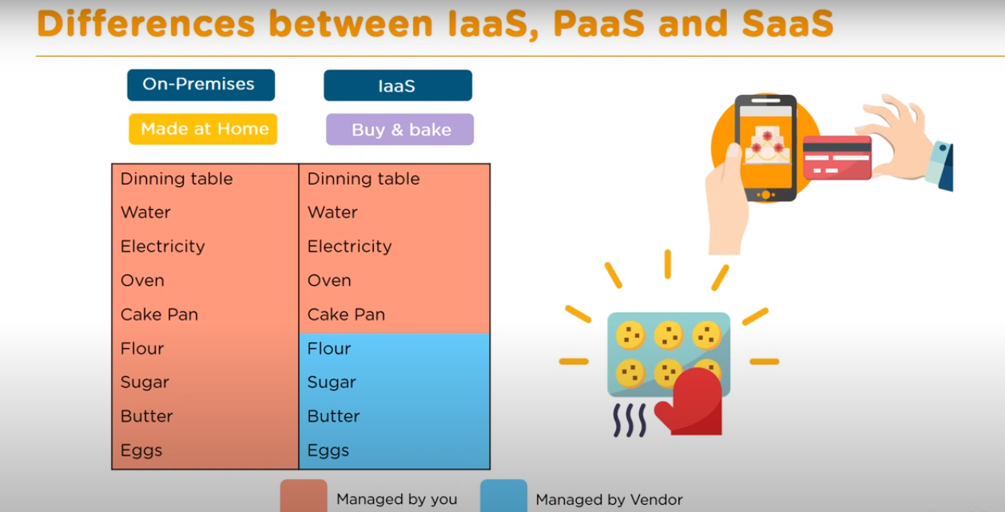

Slide 36
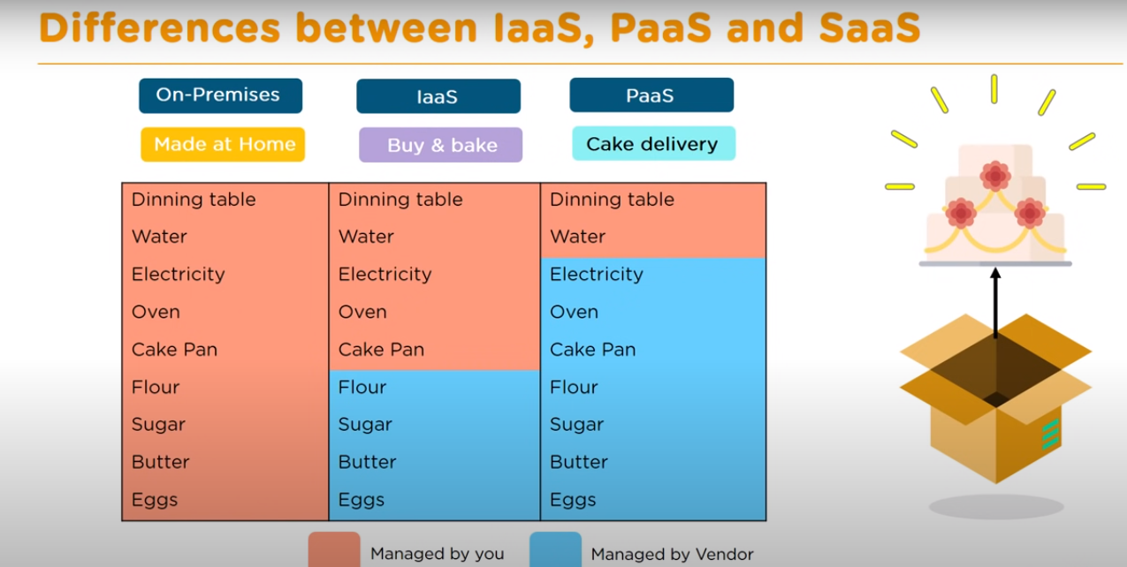

Slide 37
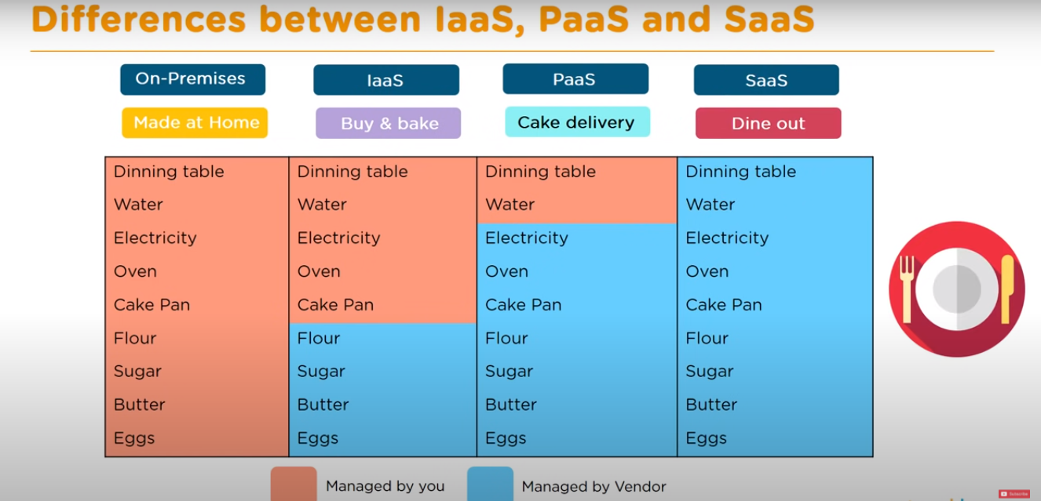

Slide 38
Where is the Cloud Going?
IDC's updated IT Cloud Services Forecast predicts that public cloud computing will grow from $17.4 billion worth of IT spend in 2009 to $44 billion by 2013. ¹
Additionally, Federal CIO Vivek Kundra has vowed to spend $19 billion of U.S. government's $70 billion IT budget on cloud computing.
The five year growth outlook remains strong, with a five-year annual growth rate of 26% – over six times the rate of traditional IT offerings.

Slide 39
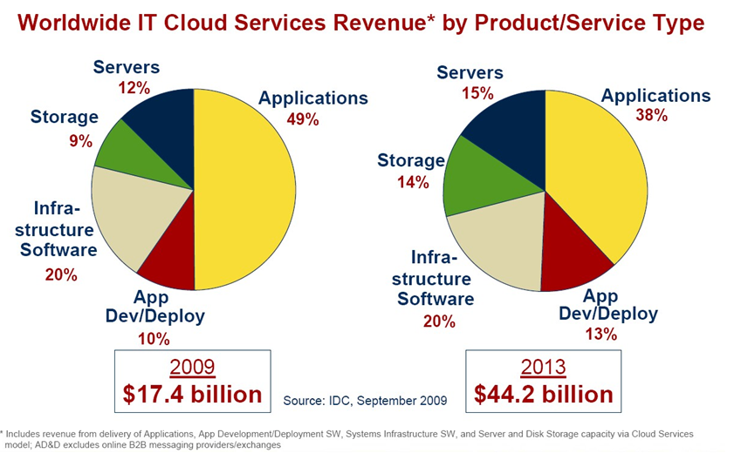
Cloud Distribution Examined

Slide 40
Why Now?
The acceptance and proliferation of hardware virtualization and multi-tenant applications
The Internet has become ubiquitous and an accepted method of connecting providers with consumers
ISPs/Telcos are offering robust, redundant and managed corporate internet service enabling service consolidation efficiencies.
The cost verses risk equation has tipped toward shared solutions
Computing capabilities are being seen as a ongoing service rather than an internal capital expense

Slide 41
Build or Rent?
The total cost of ownership to build and maintain datacenter infrastructure includes both hard and soft costs.
An accurate comparison requires knowledge of all variables over the life of the project or hardware.

Slide 42
Enterprise Cloud Solutions
Hybrid Cloud
Scalability of the Public Cloud with the control and security of a private cloud
Test / Development / QA Platform
Use cloud infrastructure servers as your test and development platform
Disaster Recovery
Keep images of your servers on cloud infrastructure ready to go in case of a disaster
Cloud File Storage
Backup or Archive your company data to cloud file storage
Load Balancing
Use cloud infrastructure for overflow management during peak usage times

Slide 43
Enterprise Cloud Solutions (cont)
Overhead Control
Lower overhead costs and make your bids more competitive
Distributed Network Control and Cost Reporting
Create an individual private networks for each of your subsidiaries or contracts
Messaging Alternatives
Replace Microsoft Exchange and SharePoint with Google Apps
Rapid Deployment
Turn up servers immediately to fulfill project timelines
Functional IT Labor Shift
Refocus your IT labor expense on revenue producing activities

Slide 44
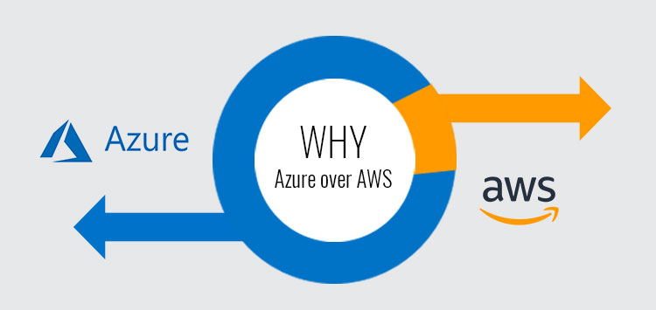
Why Azure?
Why not AWS?

Slide 45
Price ! That’s it

Slide 46
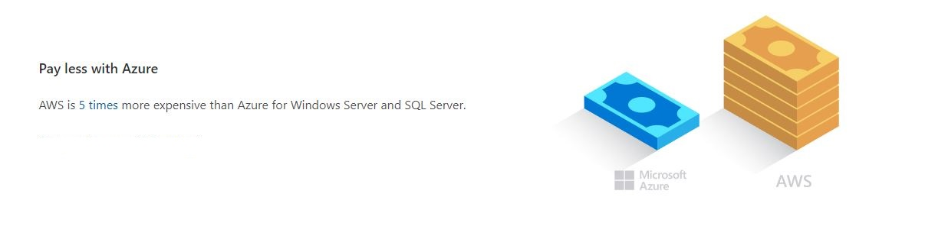

Slide 47
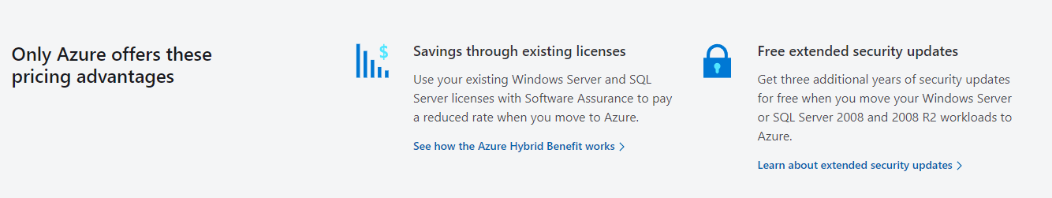

Slide 48
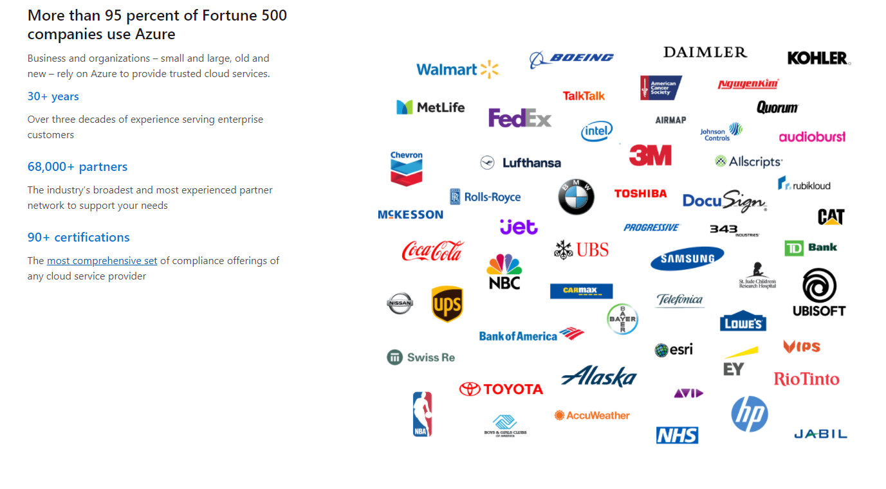

Slide 49
Conclusion
Cloud Computing is outpacing the IT industry
Real business value can be realized by customers of all sizes
Cloud solutions are simple to acquire, don’t require long term contracts and are easier to scale up and down as needed
Proper planning and migration services are needed to ensure a successful implementation
Public and Private Clouds can be deployed together to leverage the best of both
Third party monitoring services ensure customer are getting the most out of their cloud environment
Security Compliance and Monitoring is achievable with careful planning and analysis

Slide 50
Preparing for the Future
Sampling of IT skills likely to be in demand in the future
Functional application development and support
I.e. Oracle, SAP, SQL, linking hardware to software
Leveraging data to make strategic business decisions
I.e. Business Intelligence : Applying sales forecasts to inventory and manufacturing decisions
Mobile apps
Android, iPhone, Windows Mobile
WiFi engineers
USF to include broadband communications (LTE replaces GSM/CDMA)
Optical engineers
Optical offers the highest bandwidth today (PON, CWDM, DWDM)
Virtualization Specialists
Economies of scale require virtualization (server, storage, client…)
IP Engineers
Network Security Specialists
Web developers
Social Media developers
Business Intelligence application development and support

Slide 51


Cloud Computing Taxonomy
Packaged Software
Infrastructure
(as a Service)
Platform
(as a Service)
Software
(as a Service)
You manage
Applications
Applications
Applications
Applications
Data
You manage
Data
Data
Data
Runtime
Runtime
Runtime
Runtime
Managed by vendor
You manage
Middleware
Middleware
Middleware
Middleware
Managed by vendor
O/S
O/S
O/S
O/S
Virtualization
Virtualization
Managed by vendor
Virtualization
Virtualization
Servers
Servers
Servers
Servers
Storage
Storage
Storage
Storage
Networking
Networking
Networking
Networking
Higher Cost & More Control Lower Cost & Higher Agility
Notes:
This slide shows how the various options compare, then explicitly illustrates where the Windows Azure platform fits in. It’s meant to make clear in the audience’s mind the exact place in this broad area that we’re about to dig into more deeply.
Before we can understand the Microsoft cloud computing strategy, we must understand how the industry sees the landscape.
Traditionally all information technology was managed by customers on their own premises. This model provides the customer with a high degree of control, but at a high cost of capital expenditure and maintenance.
Another model is known as “infrastructure as a service ,” or IaaS, and is defined by hardware, either physical or virtual. In this model, a provider uses services in the cloud to offer the end user hardware for computing or storage needs. The end user maintains control of the operating system and applications on the hardware.
The second model is “platform as a service,” or PaaS, and is used to facilitate the development, testing, deployment, and ongoing maintenance of applications. In this model, the provider maintains and administers the underlying infrastructure for the end user.
The third model is “software as a service,” or SaaS. SaaS supplies finished services and applications over the Internet to customers who pay on a per-use basis. This is the most common form of cloud computing delivered today.
Windows Azure Platform is a Paas. Think of Windows Azure and the Platform as the operating system of the cloud. You have Windows Client which is your client PC Operating System, Windows Server which is your Operating system for your data centers and Windows Azure is your operating system for the cloud. With Windows Azure Platform, however, Microsoft manages and maintains the platform, freeing up your IT resources to focus on business objectives. Also, because Windows Azure Platform provides dynamic capacity that can scale up or down to meet your changing needs, you achieve better resources utilization and lower costs.

Slide 52
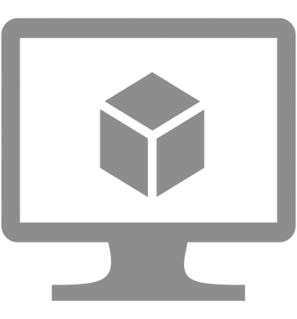


Three Main Components
Virtual machines
Cloud services
Web sites

Slide 53
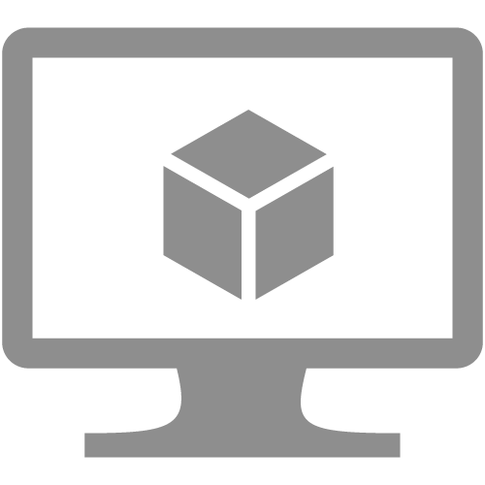
Virtual Machines
Virtual Machines
Windows Server and Linux
Flexible Workload Support
Virtual Private Networking
Notes:
Speaker Notes:
As you saw you can use both Windows Server or Linux
You can install any software you want in the virtual machine. It’s your virtual machine
You can also setup a virtual private network to connect VMs to your on-premises infrastructure

Slide 54
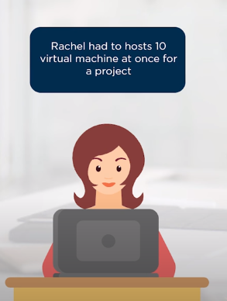
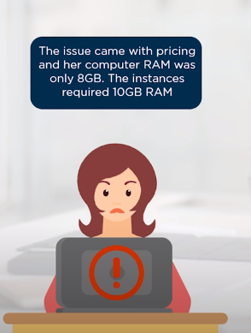
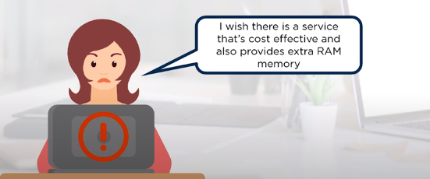

Slide 55
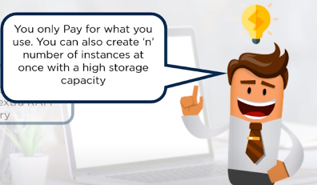
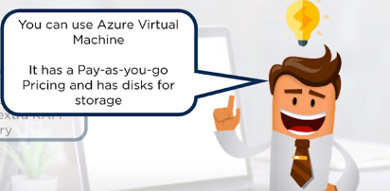


Slide 56
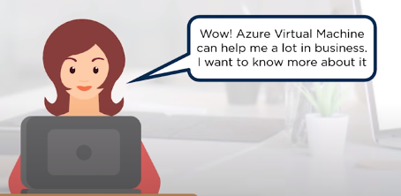

Slide 57
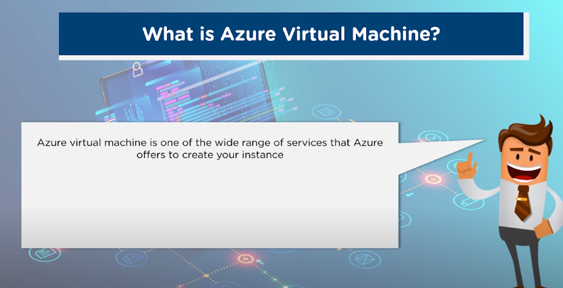
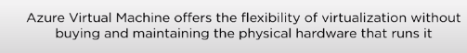

Slide 58
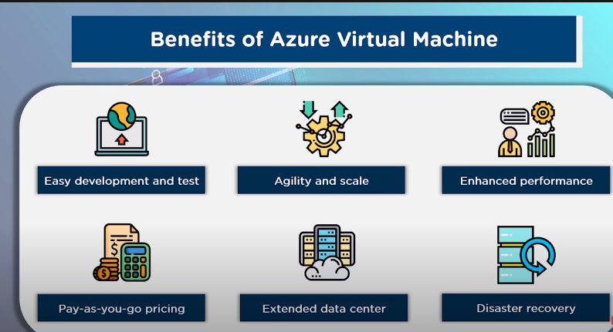

Slide 59
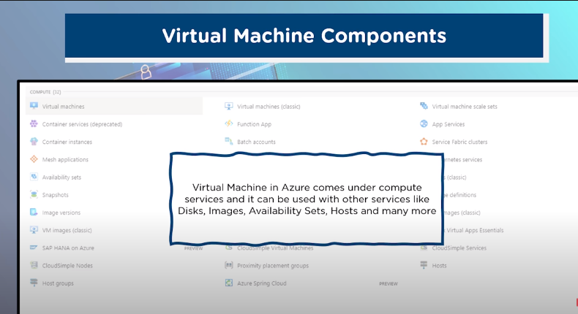

Slide 60
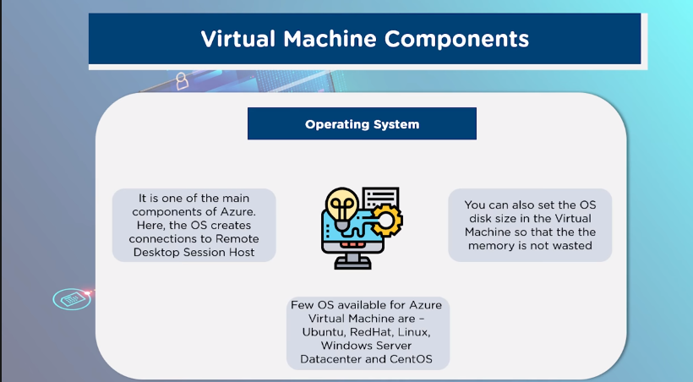

Slide 61
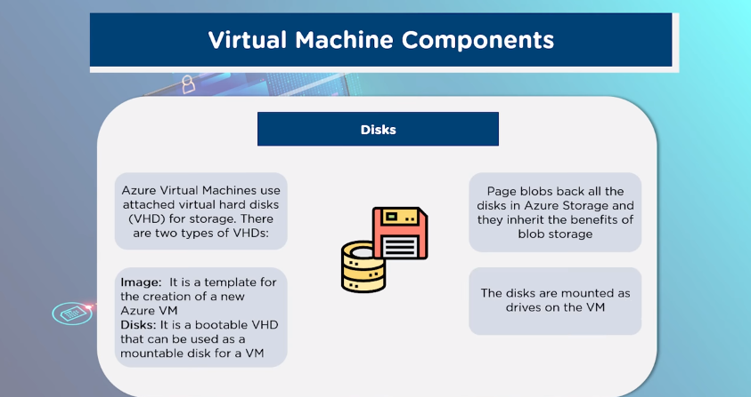

Slide 62
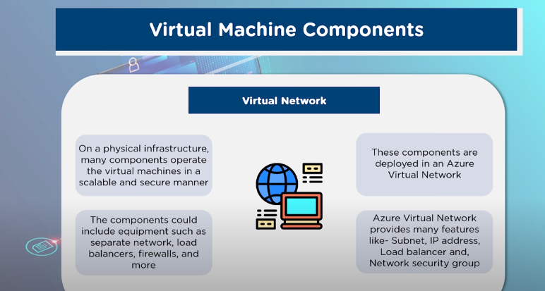

Slide 63
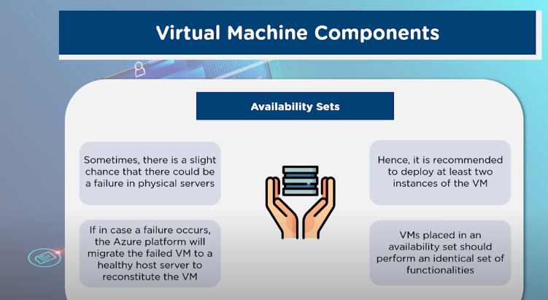

Slide 64

Web Sites
Web sites
Build with ASP.NET, Node.js or PHP
Deploy in seconds with FTP, Git or TFS
Start for free, scale up as your traffic grows
Notes:
Speaker Notes:
Transition
Virtual machine capabilities are one of the great features as part of this Azure release.
Next one I want to talk about are Windows Azure Web Sites
Basically with Windows Azure Web Sites there is a managed service that you can use to run web sites and web APIs.
You don’t have to worry or think about VMs, servers, or infrastructure.
You can simply focus on building and deploying HTTP based applications.
Enables you to build web sites using ASP.NET, Node.js, or PHP
Allows you to use any tool and any operating system to build these sites including Windows, OS X, and Linux.
You can easily deploy these sites using the tools and infrastructure you know.
We support several flexible deployment options including FTP, GIT, and Team Foundation Services
What is nice about this offering is that not only does it enable to very quickly get going, but it also allows you to start with a free offer in a shared environment.
You can then scale up these sites using reserved instances for higher performance and isolation and scale out these sites as your web site becomes successful and you have increased load.

Slide 65










Building Block Services
Big data
Database
Storage
Traffic
Application Building Blocks
Caching
Messaging
Identity
Media
CDN
Networking
Notes:
Speaker Notes:
One of the other things we do with Windows Azure to enable that is provide a bunch of Application Building Blocks
These are managed services that we run that provide a lot of value so you can avoid standing up the infrastructure for common capabilities
You always can stand up VMs and put anything you want in it
But in a lot of cases you will find that we have built in services that we deliver or that are delivered by our partners
What’s cool is that you can use any of these services with a VM, with a Web Site, or with a Cloud Service – so you have flexibility in how you will consume them.

Slide 66
SQL Database
DB
SQL Database
Relational SQL Server Engine in the Cloud
Clustered for high availability
Fully Managed Service
SQL Reporting support

Slide 67





Azure Data Centers
North America Region
Europe Region
Asia Pacific Region
N. Europe
N. Central – U.S.
W. Europe
S. Central – U.S.
E. Asia
S.E. Asia
6 datacenters across 3 continents
Simply select your data center of choice when deploying an application

Slide 68
Windows Azure Platform - CDN
North America Region
Europe Region
Asia Pacific Region
Over 2 terabits per second of capacity from over 22 global locations
Windows Azure Content Delivery Network (CDN) service scales your global reach automatically without user intervention

Slide 69
Let’s move to Demo
mstsc

